Slide 1

WaveCon Telecom Analysis Insights on 5G Launch in India since June, 2022

Slide 2
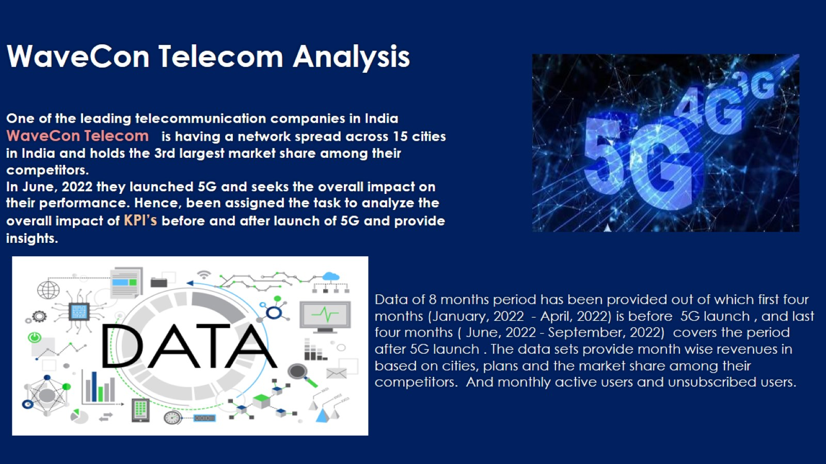
One of the leading telecommunication companies in India WaveCon Telecom is having a network spread across 15 cities in India and holds the 3rd largest market share among their competitors. In June, 2022 they launched 5G and seeks the overall impact on their performance. Hence, been assigned the task to analyze the overall impact of KPI’s before and after launch of 5G and provide insights.

Slide 3
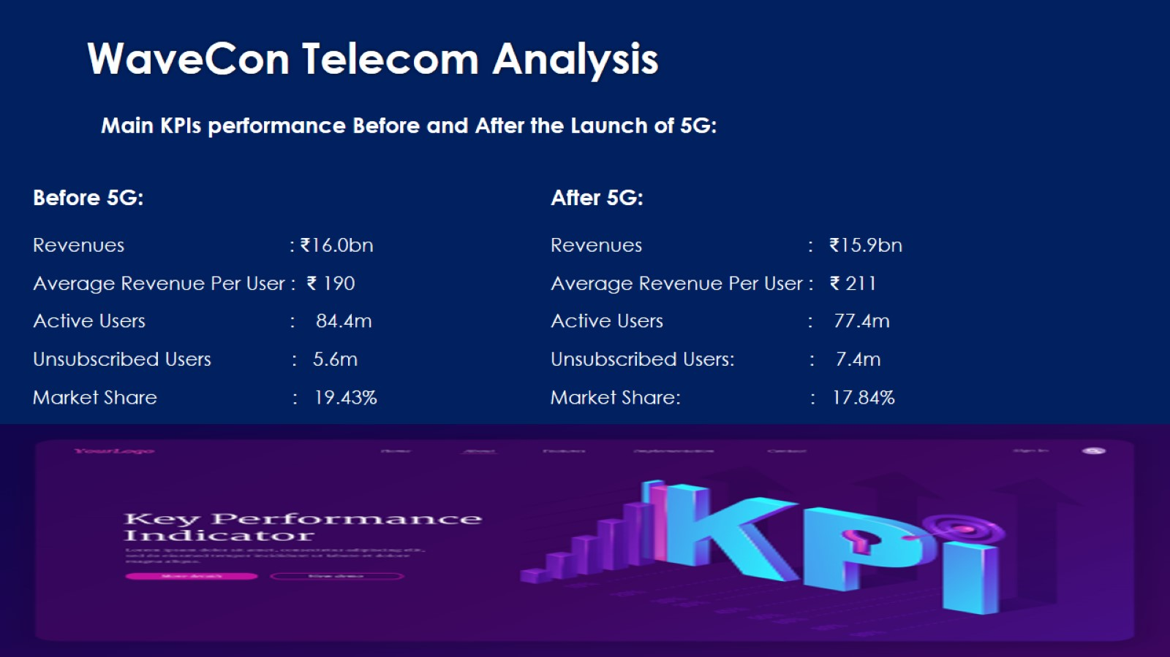

Slide 4
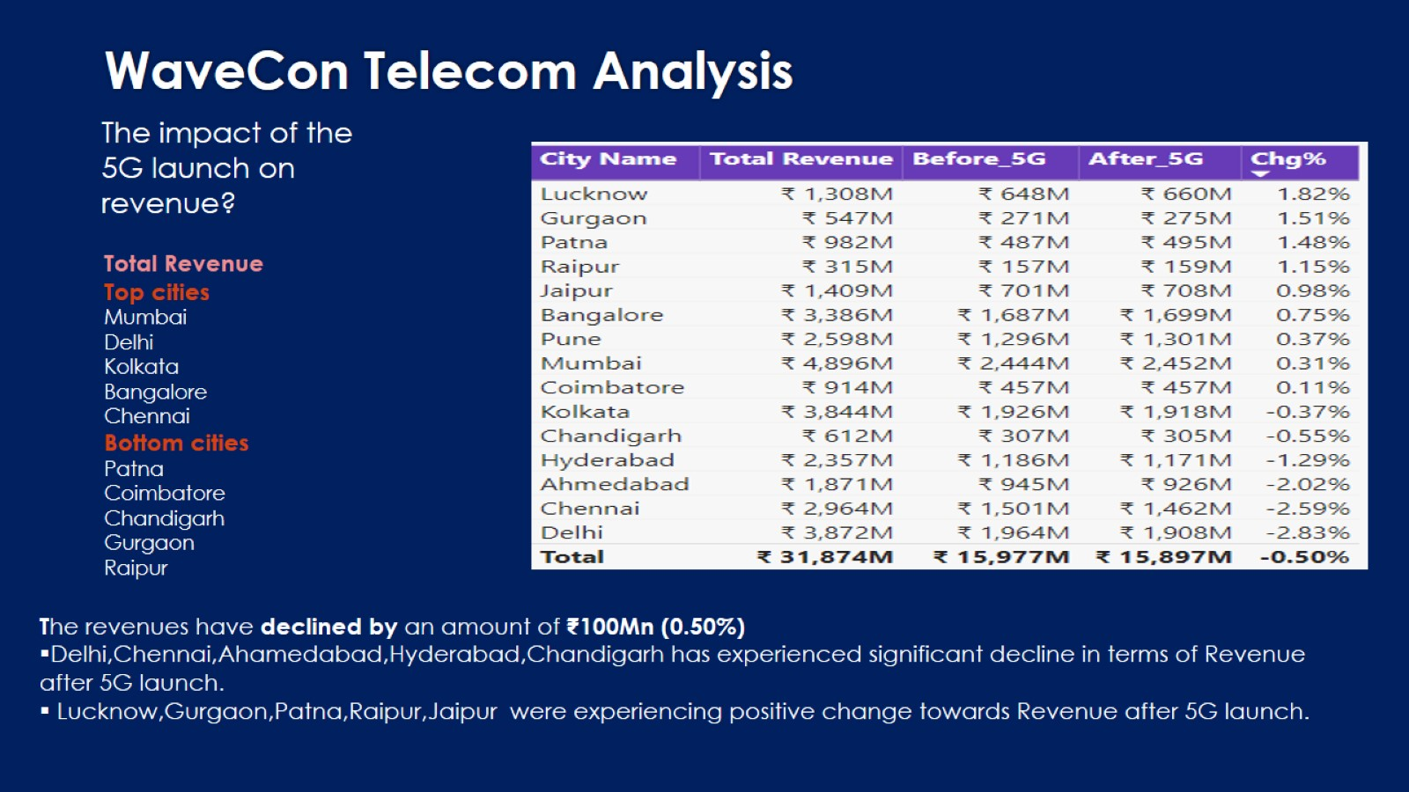

Slide 5
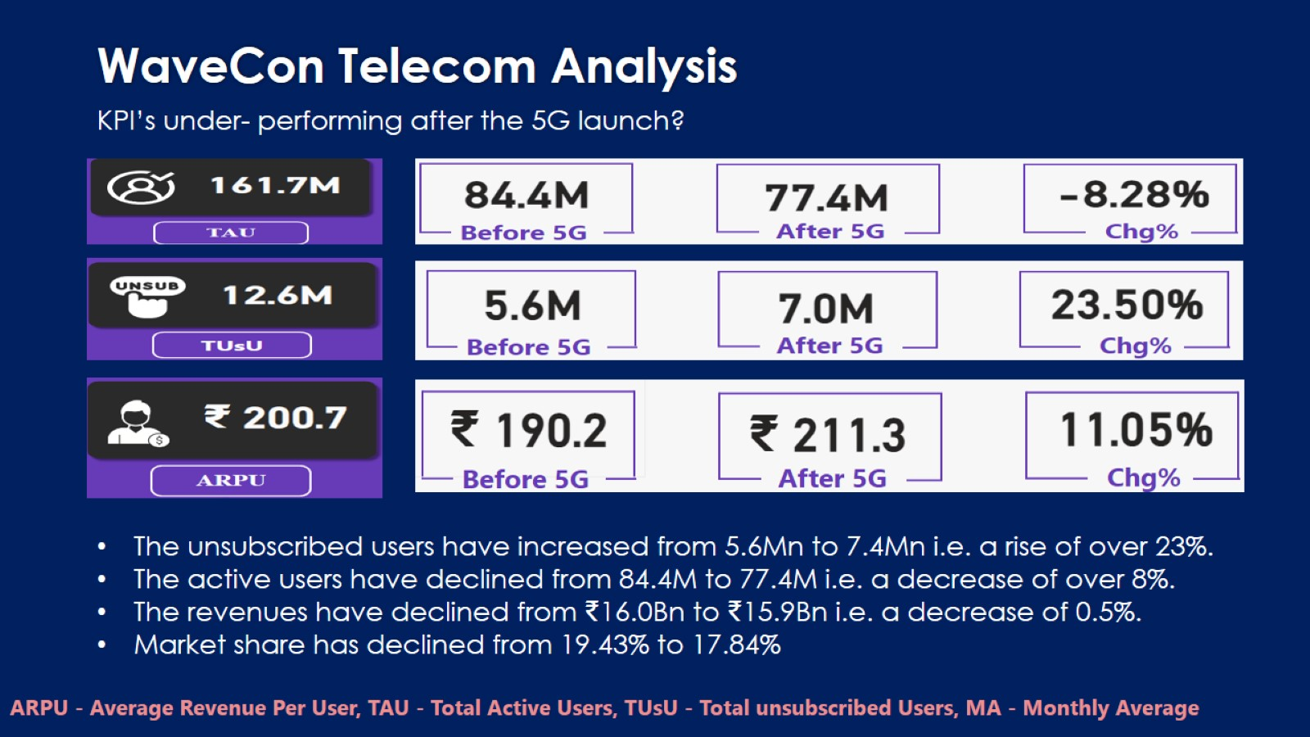

Slide 6
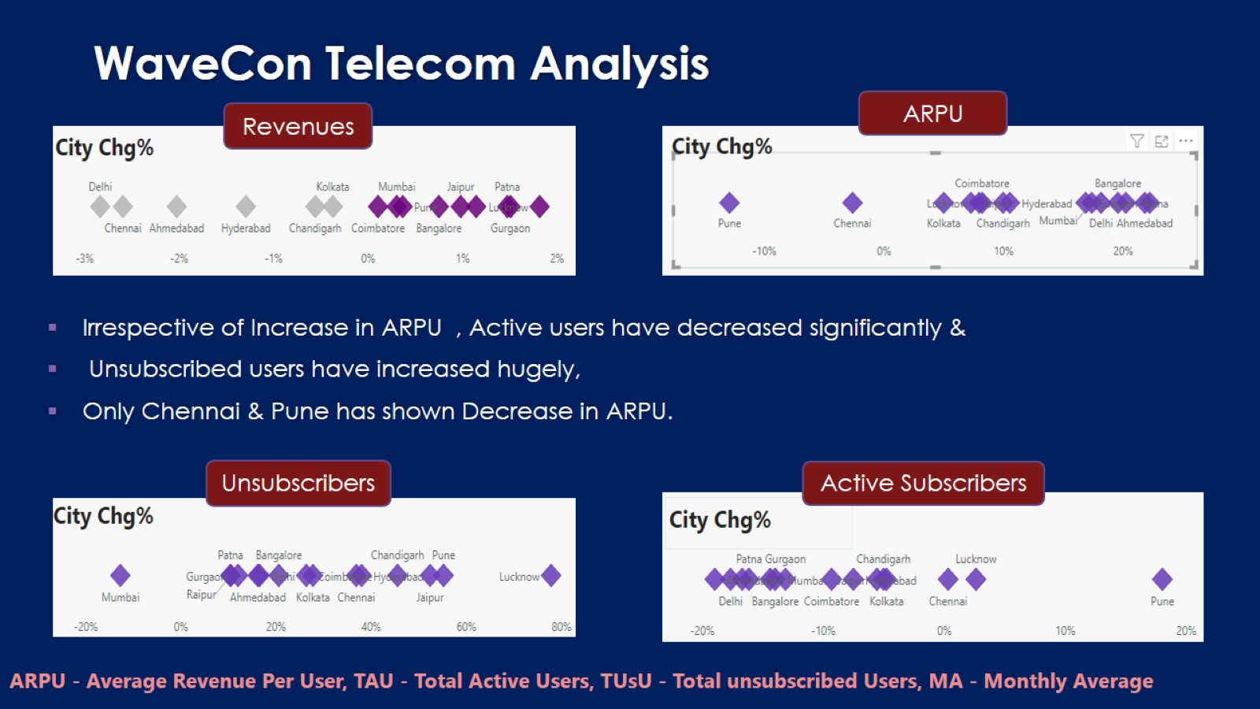

Slide 7
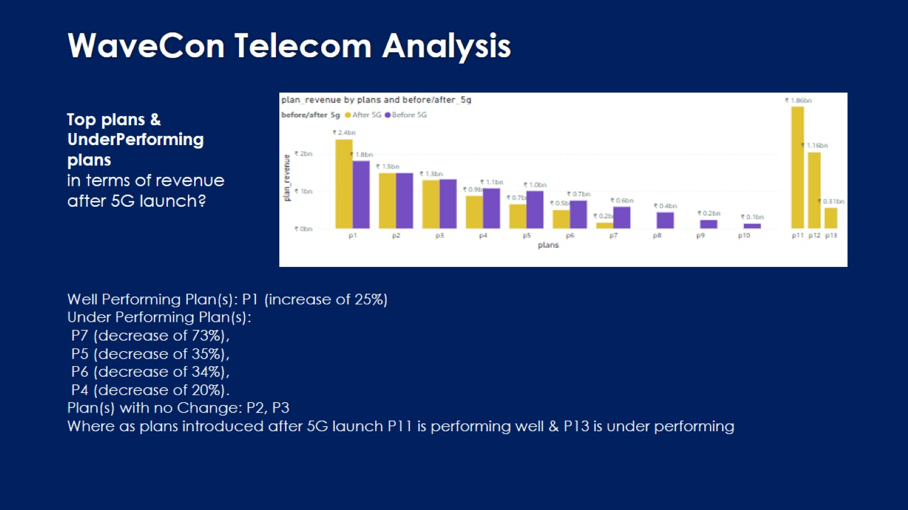

Slide 8
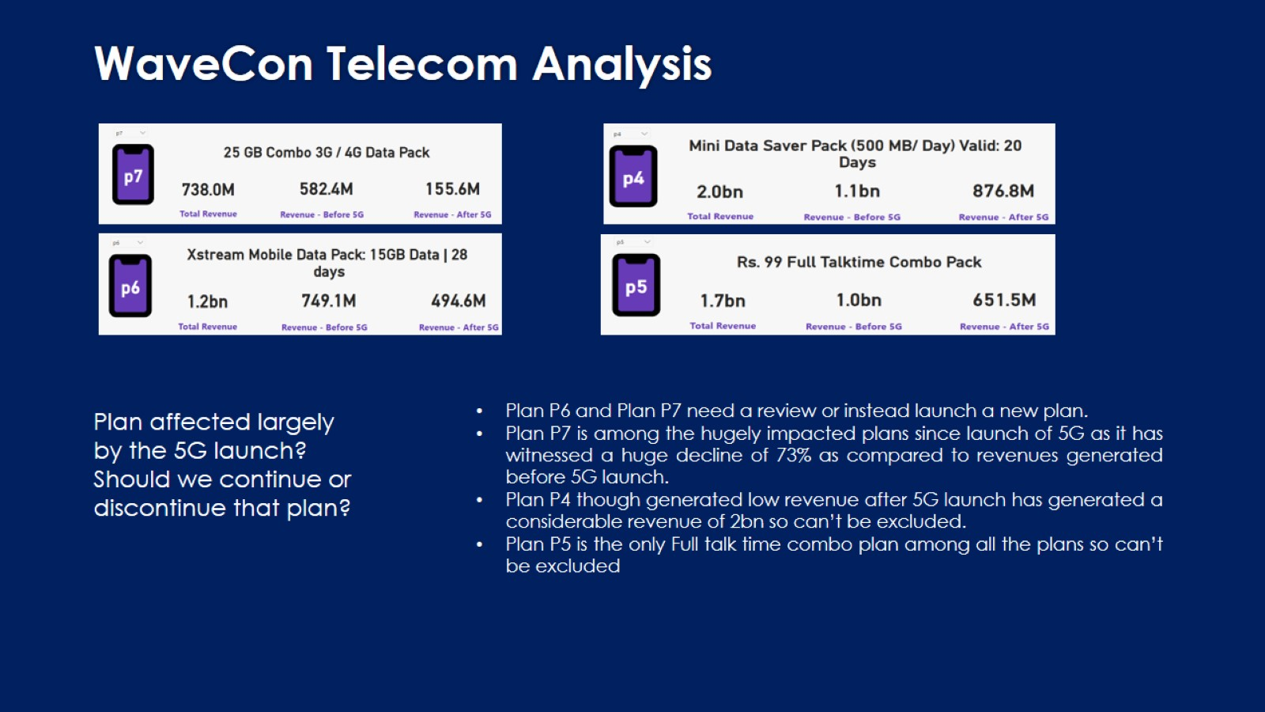

Slide 9
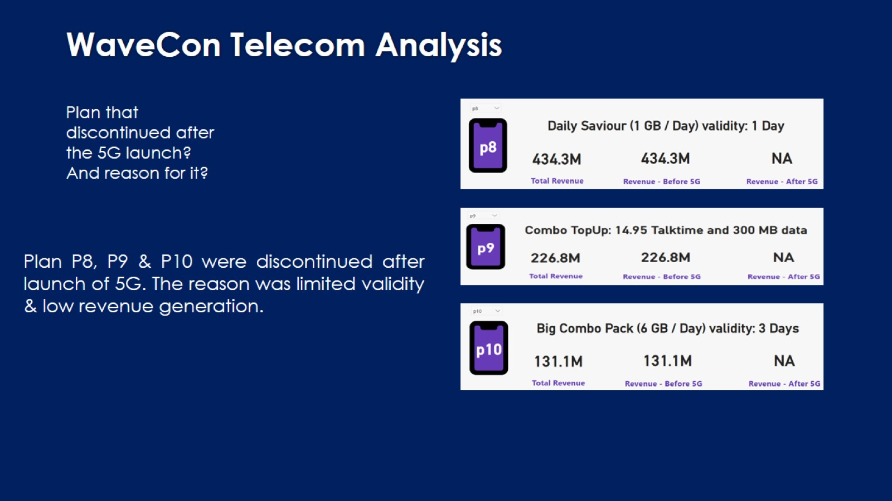

Slide 10
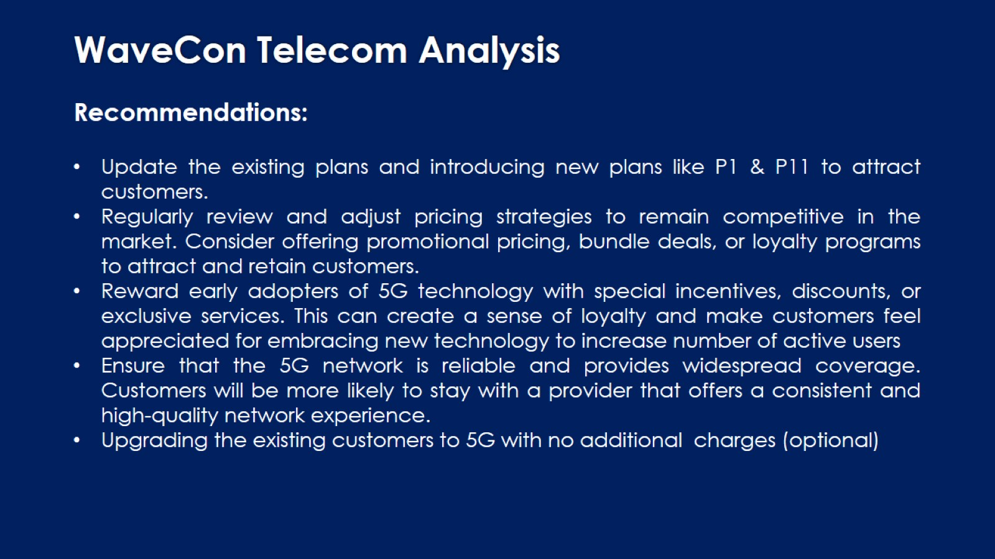

Slide 11

Thank You!

